Slide 1
C++ Review
Dec. 2017

Slide 2
Outline
Structure of C++ programs
Memory management
Namespace
Pointer and reference
Function
Object oriented programming
Class
Class inheritance
Polymorphism

Slide 3
Structure of C++ Program
More efficient (but also dangerous!)
Compiled language
Data types (int, float, double, etc.)
Management of computing resources (memory, CPU, GPU, etc.)
Preprocessor directive
file1.cpp
file2.cpp
# include “file1.h”
# include “file2.h”
…
int main()
{
return 0;
}
Main.cpp
file1.h
file2.h
…

Slide 4
Structure of C++ Program
.cpp & .h files
Preprocessing
.cpp files
Compiling
Object files (.o)
Linking
.exe file
Dynamic- link libraries (.so or .dll)
Compilation
Other .o files, statistic libraries (.a or .lib)

Slide 5
Memory management
Scope (block scope, file scope)
Linkage (internal or external)
Storage duration
Static: the entire duration of program
static const double pi = 3.1415;
Automatic: from where they defined until they go out of scope
{ …
int x = 2; // declaration and initialization
… } // end of scope
Dynamic:
creating new objects in run-time which make the application dynamic and more flexible
from where the memory is allocated by new() function until the memory is deallocated (return) by delete() function
{double *var = new double; // allocate memory
…
delete var; // deallocate memory}
Static storage (fixed size)
Stack
Automatic storage
(variable size)
Dynamic storage (free space or heap)
we determine the storage duration

Slide 6
Namespace
Namespace let us define named regions (similar to folders)
The intent is to reduce name conflicts (large programs with libraries from different vendors)
We can access items (constant variables, functions, classes, etc.) in a namespace by
‘ :: ’ operator (scope-resolution operator) e.g., std::cout << “C++” << std::endl;
using declaration (make a single name available)
using namespace directive (make all the names in a namespace available in the program)
int main()
{
using std::cout;
cout << “C++” << std::endl;
return 0;
}
int main()
{
using namespace std;
cout << “C++” << endl;
return 0;
}

Slide 7
Pointer And REFERENCE
char var = ‘a’;
Variable declaration
Data type: how much memory is required
Name: to refer to the piece of memory
Memory location: the actual memory address on RAM (we usually do not care)
A pointer is a variable that holds the memory address of an object
Pointer must be the same data type as the data object it points to
We can access and modify the value of object using dereferencing operator ‘*’
 |  | a
Name: var
Address: &var → 0018FD38
char *pVar = &var; // pointer to variable var
var = ‘c’; // changing the value with variable name
*pVar = ‘b’; // changing the value with pointer

Slide 8
Pointer And REFERENCE
It is more efficient to pass a pointer, which is just the memory address (the same size of int data type), than it is to pass the entire data structure
Pointer provide a direct link to the underlying value of variable allowing us to change the value
For dynamic variables we do know the variable name (as they may be created in run-time). Therefore we have to use pointer to work with dynamically allocated objects
{
double *var = new double; // allocate memory
*var = 2.5; // assign a value to underlying data object
*var += 0.75; // changing the value of pointed data object
delete var; // deallocate memory
}

Slide 9
Pointer And REFERENCE
A reference type is simply an alias for a data object
double x = 2.00;
double &y = x; // another name (alias) for the object
It provides a link to an existing data object
References are commonly used with parameters to functions to avoid copying the objects as well as to enable object modification by providing an external linkage to data object.
 |  | 2.00
x
y

Slide 10
Function
void swap(double *x, double *y){
double temp = *x;
*x = *y;
*y = temp;}
int main() {
double a = 4.00, b=5.5;
swap(&a, &b); // function call
return 0}
Function prototype (signature) → header file (.h file)
Function definition → source code file, object file, or library file (.cpp, .o, .lib, .a, .dll, .so)
Call function
We can pass parameters to functions by value, by pointer, and by reference
Function can have a return value or be a void function
void swap(double &x, double &y){
double temp = x;
x = y;
y = temp;}
int main() {
double a = 4.00, b=5.5;
swap(a, b); // function call
return 0}
double add (double, double);
#include “myfunc”
double add (double x, double y){
return x + y;
}
#include <iostream>
#include “myfunc”
int main()
{
double a, b;
std::cout << “a + b =“ << add(a,b) << std::endl;
return 0;
}
Return data type
Function name
List of input parameters data type
return statement
header file (myfunc.h)
Source code file (myfunc.cpp)

Slide 11
Function
double add (double x, double y = 1.5); // function prototype
int main()
{ … double a, b, c;
c = add(a,b); // add with two function parameters
c = add(a); // add with one function parameter
}
double add (double x, double y){
return x+y;}
Default arguments
Function overloading
double add (double x, double y); // add for double data type
int add(int x, int y); // add for int data type
int main()
{ … double a, b, c;
int x, y, z;
c = add(a, b); // double version will be called
z = add(x, y); // int version will be called
}
double add (double x, double y){ return x+y; }
int add(int x, int y){ return x+y; }

Slide 12

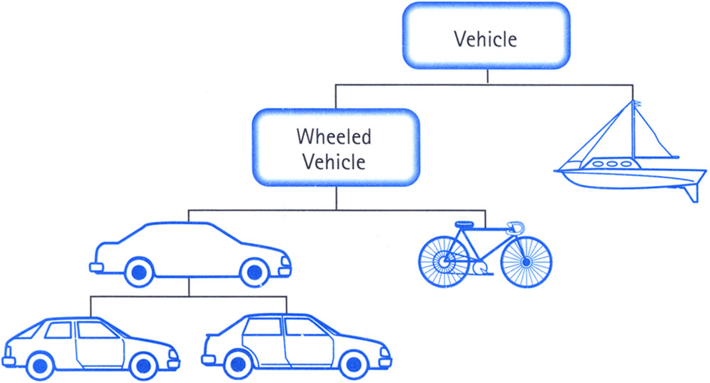
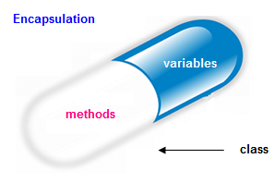
Object oriented programming
Procedural vs Object Oriented programming (OOP)
Procedural focuses on how to do tasks and then on how to present data to the processes
OOP first focuses on data presentation and then operations for interacting with data so the features of data objects orients the program
Why OOP
Abstraction
Encapsulation
Data hiding
Inheritance
Code reusability
An example
Making an ATM application requires objects for customer, bank account, transaction, etc. and some operations for their interaction with each other
Complex Logic
Turn on/off
Change channel
turn up volume

Slide 13

Class
Enables creation of custom, self-contained, and reusable types for real world objects
Class is a blueprint for objects
Class is a tool for translating OOP features to user-defined types
A class in C++ has declaration (header file) and definition (source file)
Class uses access levels for abstraction and data hiding
Public: accessible by users
Private: hidden from users
Protected: hidden from users but accessible through inheritance
Class contains data (member) and member functions (methods)
Constructor is executed upon object creation
Destructor is executed when object gets destroyed
Multiple constructors
Initialization list
Object instantiation
class Car
{
public: // available to user
Car(); // default constructor
Car(string&, int);
~Car(); // destructor
void info();
private: // hidden from the user
string model;
int year;
};
Car::Car()
: model(“”), year(1900) {}
Car::Car(string &m, int y)
: model(m), year(y) {}
Car::~Car() {}
void Car::info()
{ cout << model << “, “ << year << endl;
}
#include “Car.h”
int main() {
Car car1; // instantiation
Car car2(“BMW”, 2017);
car1.info();
car2.info();
return 0;
}

Slide 14
Class inheritance
class Vehicle
{
public:
Vehicle(string &m, int y)
: model(m), year(y) {}
~Vehicle();
void info();
private:
string model;
int year;
};
One of the main goals of OOP is to provide reusable code.
Many vendors offer class libraries which consist of class declarations and implementations and each class is a package of data plus methods
Implementation as source code → modify class definition if possible
Implementation as compiled file (object file or library file) → class inheritance
Inheritance
Adding new functionality
Adding new data
Modifying class methods (member function overloading)
Combining multiple classes (multiple inheritance)
Typically we use public inheritance
Class inheritance establish an “IS-A” relationship
class Car : public Vehicle
{
public:
Car(string &m, int y, int p, int x, int y)
: Vehicle(m,y), power(p), milage(x), MPG(y) {}
~Car();
void info();
private:
int power;
int milage;
int MPG;
};
New data
A
C
E
F
D
G
B

Slide 15
Polymorphism
In C++ We usually use pointers (and references) to work with objects for efficiency
Due to IS-A relationship between base and derived classes a pointer or reference to the of base class is type-competitive to refer to all derived classes
Always ask if an object inherently belongs to a pointer type (for example a car can be pointed to by a vehicle pointer)
Using pointers (and references) from base class to access (and work with) objects from derived classes is called polymorphism
Why polymorphism?
We can use the same functions for derived objects
We can group the derived objects together
Two mechanisms for implementing polymorphic inheritance
Redefining base-class methods in a derived class
Using virtual methods
A virtual method is a member function in the base class that can be replaced by overloaded member function from the derived class depending on what data type the base-class pointer points to
Virtual function is specified by using virtual keyword in method prototypes in the class declaration

Slide 16
Demonstration
Person
Researcher
Student
Employee
Graduate student
Faculty

